Slide 1
Crop analysis and Disease Classification System
Mr. Devdas - Guide

Slide 2
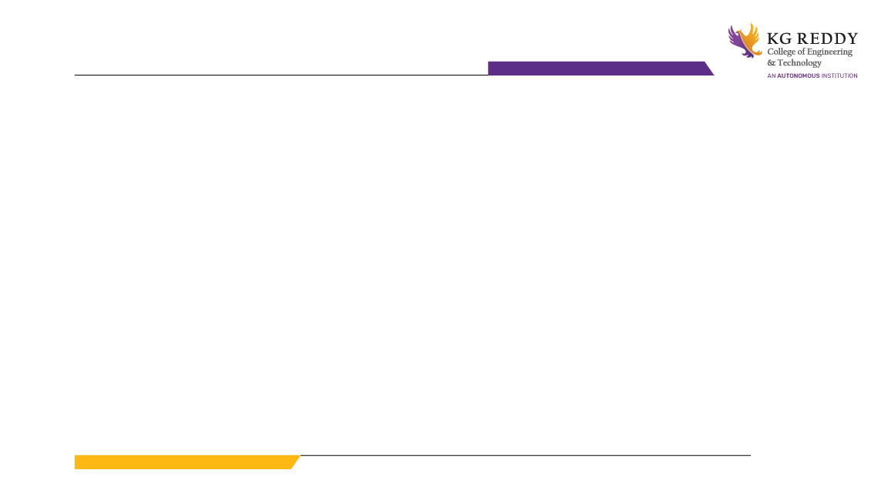
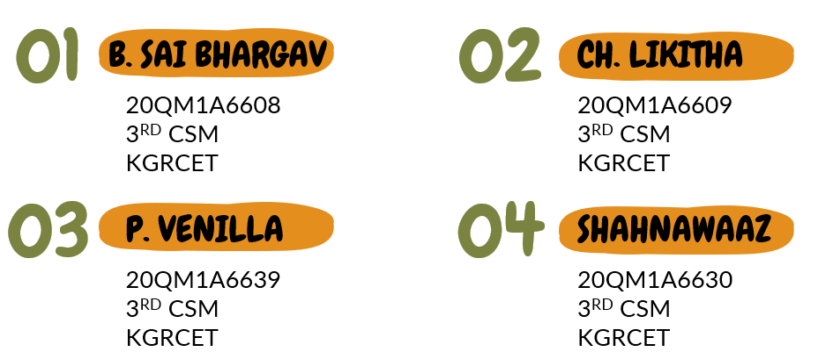
MINI PROJECT GROUP 7

Slide 3
Problem Statement :
Many farmers in India don’t know what type of crops they need to grow on their farm depending on their soil conditions and the water resources available in their village.
Due to these unknown conditions, they try to grow different types of crops but fail to harvest a good yield.
They don’t know what type of disease their crops are suffering with.
They don’t know what type of pesticides, insecticides and fertilizers that crops in the farm require.
This makes them to spend money on large amounts of fertilizer's, pesticides, and insecticides unnecessarily also damages crop which even don’t require.

Slide 4
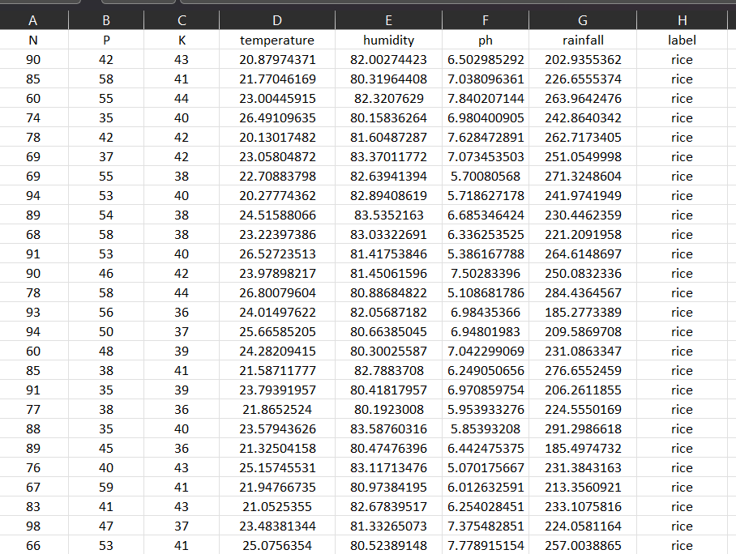
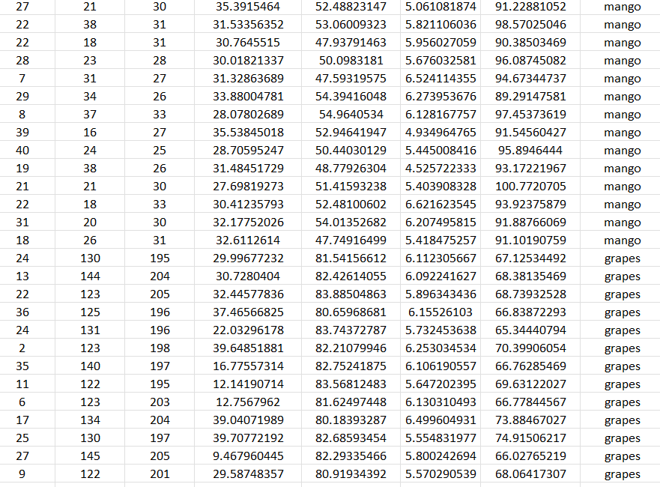
DATASETS :
1) Crop Prediction :
Crop Prediction Data, CSV file format

Slide 5
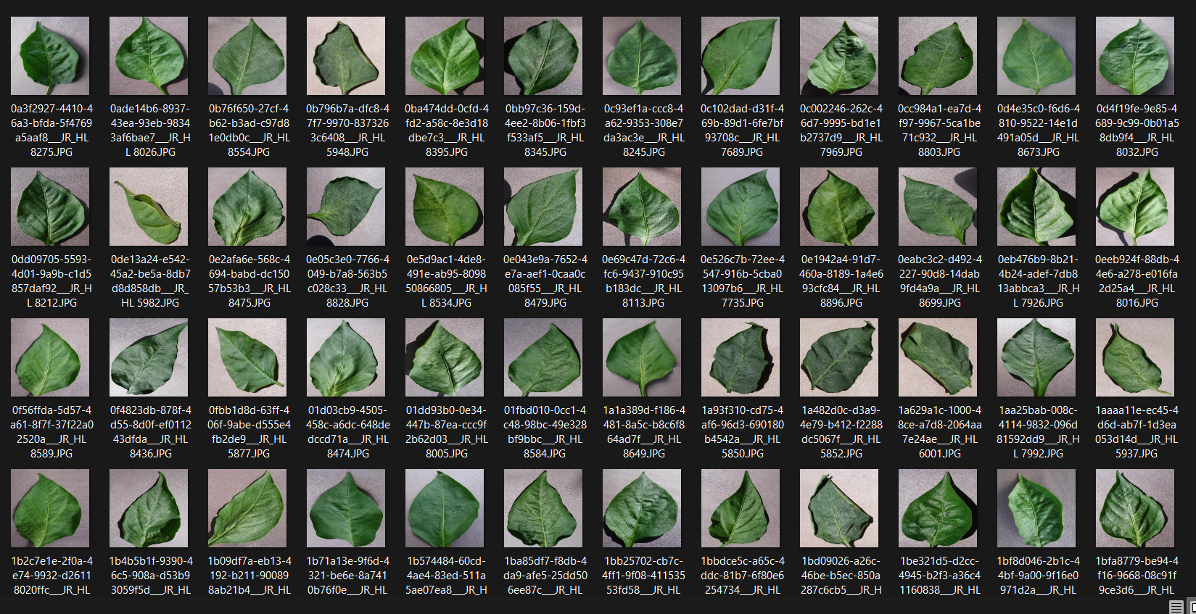
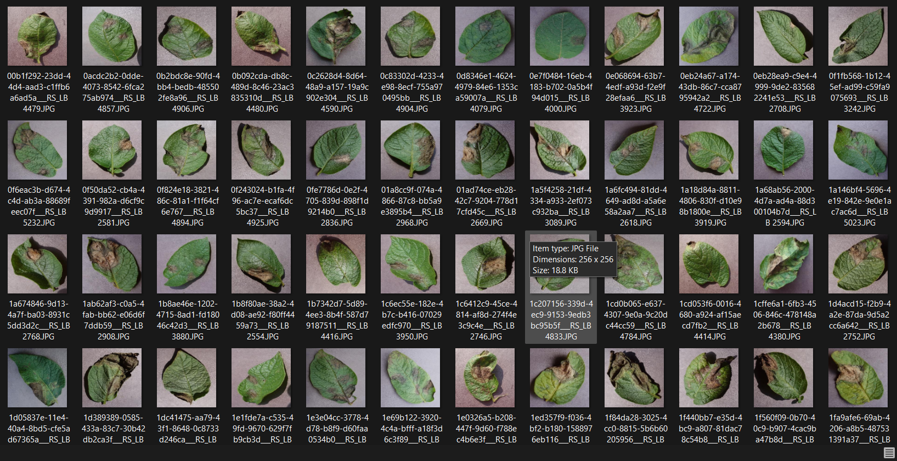
DATASETS :
2) Crop Disease Classification :
Crop Disease Classification Data, CSV file format

Slide 6
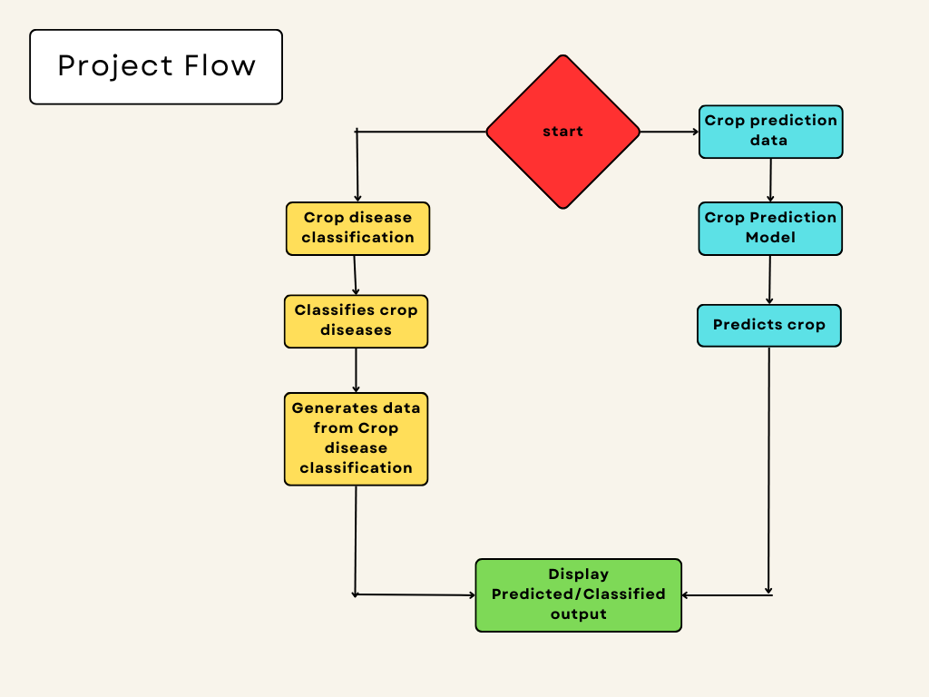

Slide 7
MODULES:
Crop Prediction :
1) Decision Tree
Step-1: Begin the tree with the root node, says S, which contains the complete dataset.
Step-2: Find the best attribute in the dataset using Attribute Selection Measure (ASM).
Step-3: Divide the S into subsets that contains possible values for the best attributes.
Step-4: Generate the decision tree node, which contains the best attribute.
Step-5: Recursively make new decision trees using the subsets of the dataset created in step -3. Continue this process until a stage is reached where you cannot further classify the nodes and called the final node as a leaf node.
Example
1) Suppose there is a candidate who has a job offer and wants to decide whether he should accept the offer or Not.
2) So, to solve this problem, the decision tree starts with the root node (Salary attribute by ASM).
3) The root node splits further into the next decision node (distance from the office) and one leaf node based on the corresponding labels.
4) The next decision node further gets split into one decision node (Cab facility) and one leaf node.
5) Finally, the decision node splits into two leaf nodes (Accepted offers and Declined offer).

Slide 8
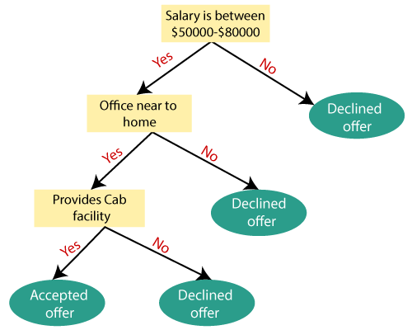

Slide 9
MODULES:
Crop Prediction :
2) Random Forest :
Step-1: Select random K data points from the training set.
Step-2: Build the decision trees associated with the selected data points (Subsets).
Step-3: Choose the number N for decision trees that you want to build.
Step-4: Repeat Step 1 & 2.
Step-5: For new data points, find the predictions of each decision tree, and assign the new data points to the category that wins the majority votes.
Example:
Suppose there is a dataset that contains multiple fruit images.
So, this dataset is given to the Random forest classifier. The dataset is divided into subsets and given to each decision tree.
During the training phase, each decision tree produces a prediction result
when a new data point occurs, then based on the majority of results, the Random Forest classifier predicts the final decision

Slide 10
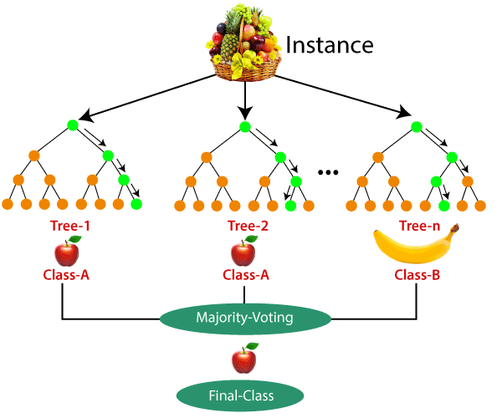

Slide 11

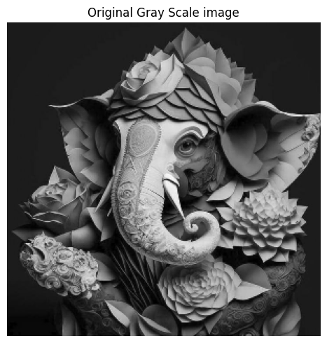
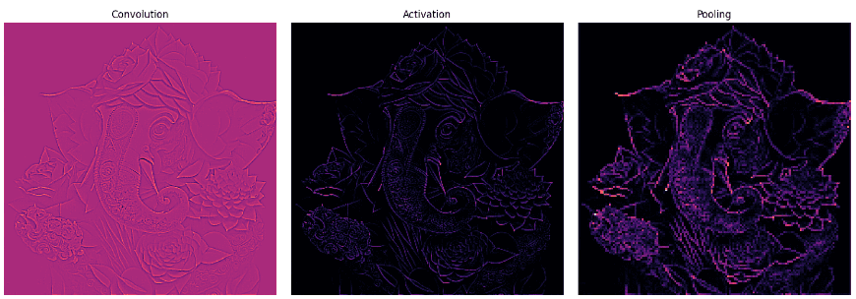
MODULES:
2) Crop disease classification :
Example:
Conventional Neural Networks:
VGG16
Import the libraries for VGG16.
Create an object for training and testing data.
Initialize the model,
Pass the data to the dense layer.
Compile the model.
Import libraries to monitor and control training.
Visualize the training/validation data.
Test your model.

Slide 12
Result :
The result of the project is a set of predictive models for crop selection and disease classification in potatoes, peppers, and tomatoes. These models have been trained and validated using relevant data sources, achieving satisfactory accuracy levels in their predictions. The prototype or proof-of-concept (PoC) has been developed and demonstrated its functionality in providing actionable insights to farmers.
The project has shown its potential to address the market's need for accurate crop predictions and disease classifications, empowering farmers with valuable information to optimize their farming practices. The project's success in achieving the stated objectives and delivering tangible benefits to the agricultural industry is a testament to its value and potential impact.
Overall, the project has laid a strong foundation for a valuable product that can revolutionize crop selection and disease management in agriculture, contributing to improved yields, reduced costs, and sustainable farming practices.

Slide 13
Conclusion :
In conclusion, the project focused on crop prediction and disease classification has yielded promising results and holds significant potential for the agricultural industry. By leveraging machine learning algorithms and utilizing key factors such as soil conditions, weather data, and other parameters, the project successfully developed models for predicting the optimal crop type to be grown and classifying diseases in potatoes, peppers, and tomatoes.
The innovative aspect of the project lies in its ability to provide accurate recommendations based on data analysis, enabling farmers to make informed decisions regarding crop selection and disease management. The usability and acceptance of the innovation among the target group, primarily farmers and agricultural stakeholders, have been positive, indicating its practical relevance in the market.
The project has demonstrated economic viability by optimizing resource allocation, reducing costs, increasing crop yield, and improving market access for farmers. It has the potential to generate profits through cost savings, increased productivity, and value-added services. Furthermore, the innovation promotes environmental sustainability by encouraging sustainable farming practices, reducing chemical usage, and conserving biodiversity.

Slide 14


